Slide 1
Churn Data Analysis
Understanding and Predicting Customer Churn
Sandeep Hegde

Slide 2
Problem Statement
About Dataset
This is a dataset contains Customers subscriptions records with company and it has various features related to customer demographics, usage frequency, interactions, and financial metrics.
Problem Definition
The objective is to develop a model that can differentiate between customers who will churn and those who will stay with the company, using the provided features.

Slide 3
Dataset Overview:
Customers subscriptions records with company
Number of records: 4,40,833
Number of features: 11
All Features:
Customer ID | Payment Delay
Age | Subscription Type
Gender | Contract Length
Tenure | Total Spend
Usage Frequency | Last Interaction
Support Calls

Slide 4
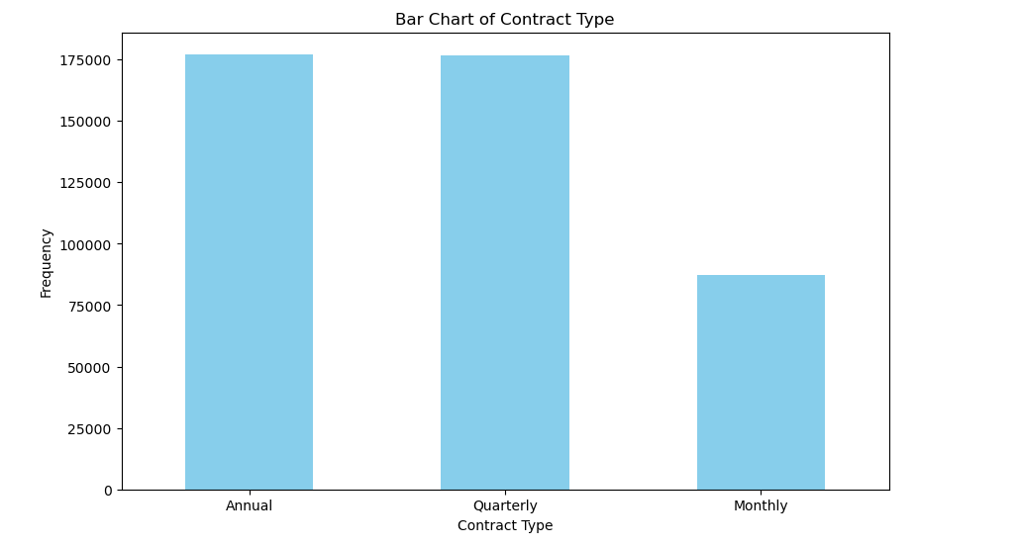
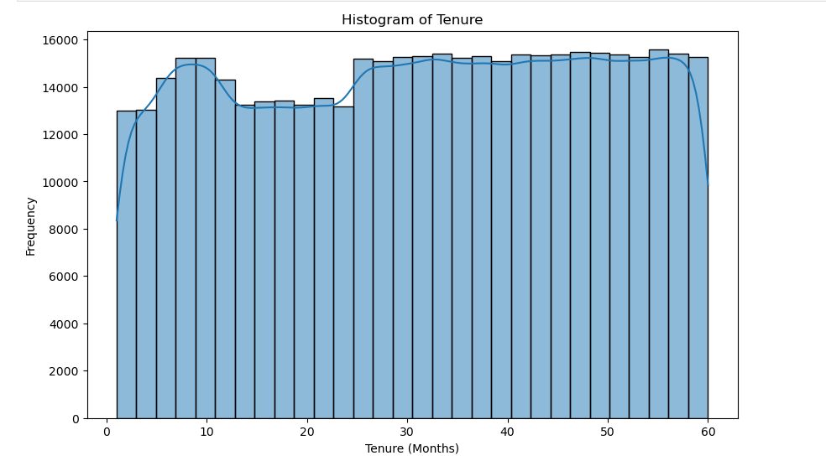
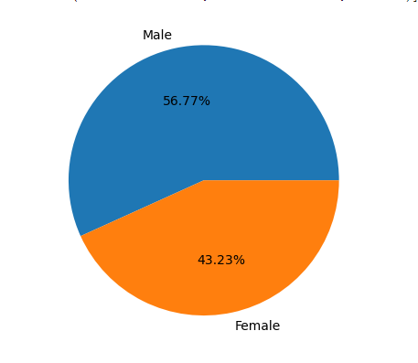
Exploratory Data Analysis (EDA) - 1
Key Observations:
Customers with monthly contracts have lower frequency compared to annual or quarterly contracts.
As the tenure distribution is uniform, it might suggest that customers are equally likely to churn at any point in time.There are no specific periods where churn is more or less likely.
A higher percentage of males customers indicates that males are the dominant group in our dataset.

Slide 5
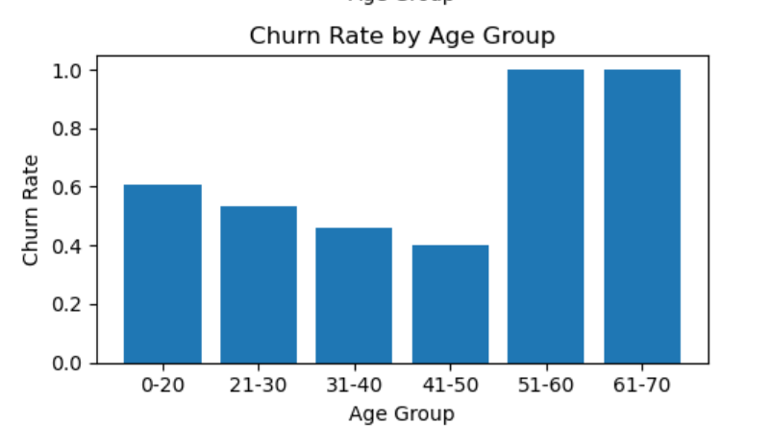
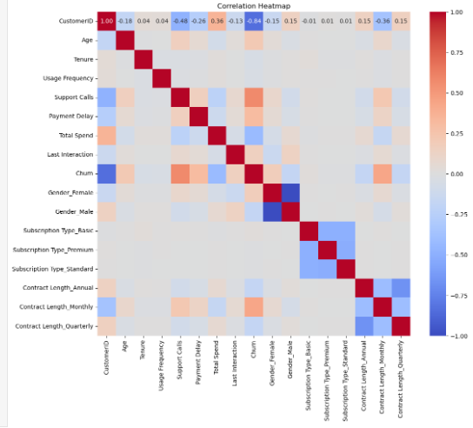
Exploratory Data Analysis (EDA) - 2
Key Observations:
Customers with age group 51-70 having a churn rate of 100%.
From Correlation Analysis :
Subscription Type are highly associated with churn.
Payment Delay significantly affects churn.

Slide 6
Model Evaluation
Performance Metrics: Present the performance metrics used to evaluate the model are accuracy, precision, recall, F1-score
Results:
All models are more accurate in predicting instances of class 'Churning Out' than class 'Not Churning Out‘
Model is over fitting.
 | Gradient Boosting
Class | Precision | Recall | F1-Score | Support
0 | 0.94 | 0.27 | 0.42 | 33881
1 | 0.55 | 0.98 | 0.70 | 30493
Accuracy | 0.90
 | Logistic Regression
Class | Precision | Recall | F1-Score | Support
0 | 0.81 | 0.43 | 0.56 | 33881
1 | 0.58 | 0.89 | 0.70 | 30493
Accuracy | 0. 8545
 | Adaptive Boosting
Class | Precision | Recall | F1-Score | Support
0 | 0.72 | 0.42 | 0.53 | 33881
1 | 0.56 | 0.82 | 0.66 | 30493
Accuracy | 0.90

Slide 7
Model Selection
Chose Model:
Gradient Boosting
Logistic Regression
Adaptive Boosting
Chosen Model:
Logistic Regression
Reasoning:
Higher Precision for Class 1: Logistic regression has higher precision for class 1, making it preferable if minimizing false positives for this class is crucial.
Higher Recall for Class 0: Logistic regression has higher recall for class 0, which is important if it's critical to identify as many true positives as possible in this class.
Better Balance (F1 Score) for Class 1 and Class 0: The higher F1 score for class 1 and class 0 with Logistic regression indicates a better overall performance in terms of balancing precision and recall for this important class.

Slide 8
Methodology
Data Cleaning
Handled missing values
Implemented data encoding where necessary for modeling.
Exploratory Data Analysis
Data Visualizations
Correlation Analysis
Split Data into Training and Test Sets
Model Training
Gradient Boosting
Adaptive Boosting
Logistic Regression
Model Evaluation
Accuracy Score
Confusion Matrix
Classification report
Model Selection

